Slide 1
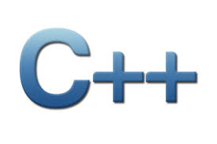

Css 332
Programming Issues with Object-Oriented Languages
Morteza Chini
Presentation material partially borrowed from learncpp.com

Slide 2
week I
Autumn 2017
Transition From Java to C++

Slide 3
Today in CSS 332
Brief introduction to C++ programing language
C++ toolchain
Fundamental data type (Primitive type)
Type conversion
Pass by value/pass by reference
We will be working in teams of 2 for duration of the quarter to practice agile software development

Slide 4
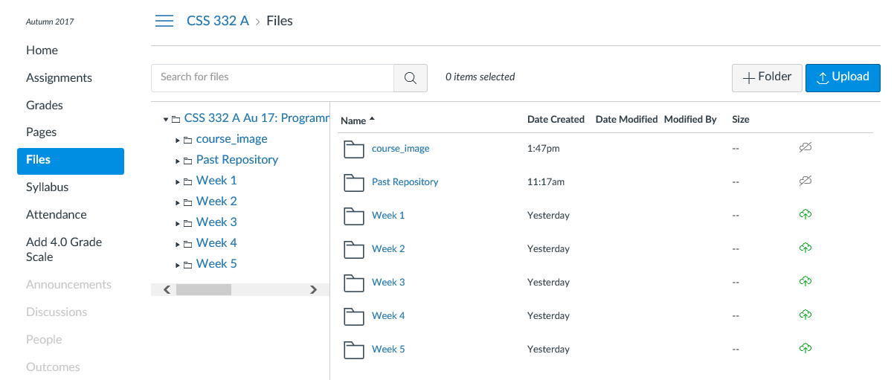
get the lab assignment here

Slide 5



C++, rope to hang yourself
Googleimages.com

Slide 6
language paradigms
Structured/procedural programming
Process-oriented
Based on the von Neumann architecture (CPU is separate from the memory)
(Decoding an instruction -> getting the operands -> computing the result -> writing the result back to memory & repeat…)
Primary problem-solving technique
Decompose a problem algorithmically
Each module in the solution solves a major step in the overall process
Determine what tasks need to be accomplished; then write functions to accomplish these tasks and send information, variables, into the functions

Slide 7
language paradigms (cont.)
Object-oriented
Data-oriented
Supports data abstraction which encapsulates processing with data objects, hiding access to data. Primary problem-solving technique:
Decompose a problem by the key abstractions and make them objects
Objects receive messages and do their tasks (calling functions)
Instead of asking what tasks to accomplish, you model the world of the problem into classes of objects and then ask what tasks our objects do

Slide 8
Before c++ there was c
C language was developed in 1972 by Dennis Ritchie at Bell Telephone laboratories as a language to write operating system
The primary goals were to:
Produce a minimalistic language that is easy to compile
Allow efficient access to memory
Produce efficient code
Eliminate the need for extensive run-time support

Slide 9
Before c++ there was c (cont.)
C turned out to be so efficient that the authors rewrote most of the UNIX operating system using C. Previously OS’s had been written in assembly, which ties a program to a specific CPU. C has excellent portability, allowing UNIX to be recompiled on many different types of computers and speeding its adoption

Slide 10
Before c++ there was c (cont.)
C++ was developed by Bjarne Stroustrup at Bell Labs as an extension to C,
starting in 1979
C++ adds many new features to the C language
Is perhaps best thought of as a superset of C
C++ supports object-oriented programming
C++ was ratified in 1998 by the ISO committee, and again in 2003 (called C++03)
Two updates to the C++ language (C++11 and C++14, ratified in 2011 and 2014 accordingly)
We will not cover C++11 and C++ 14 in this class

Slide 11
c/C++ philosophy
The underlying design philosophy of C and C++ can be summed up as
“in programmer we trust”:
Wonderful -- the compiler will not stand in your way if you try to do something unorthodox that makes sense
Dangerous -- the compiler will not stand in your way if you try to do something that could produce unexpected results
For new programmers that is one of the primary reasons why knowing what you shouldn’t do in C++ is almost as important as knowing what you should do

Slide 12
Making the transition to C++

Slide 13


Overview of differences
Supports Object Oriented Programming
Does not have a processor
Has no header files
Uses garbage collector to free memory
Memory leak safe
No support of pointer concept
No operator overloading feature
Supports both procedural and OOP
Compilation stage called pre-processor
Keeps definitions in header files
Explicit freeing of memory
Memory leak prone
Makes extensive use of pointers
Operator overloading an important feature

Slide 14

C++ subtle differences
import | # include
null | NULL
boolean | bool
final | const
Method | Function
class Test { } closes a class definition | class Test{ } ; semi-colon needed as well
Dot operator( . ) | . : :: ->
Global Variables not allowed | Global variables, constants, and functions
System.out.println(); | cout << & cin>>
Class/method definition must be available | Class/function must be defined before use
Multiple inheritance not allowed | Multiple inheritance supported
main() method is a type void | main() is a type integer

Slide 15
C++’s Versatility
C++ is able to run on essentially any computer system, as long as your compiler has converted your source code into machine code for that specific system
A different compiler must be used for each system the program will run on, and a program compiled by a Windows compiler should not be run on a Linux system
The individual compiler determines the sizes of variables in memory, so that programs relying on variable size need to be carefully planned to ensure portability between systems.

Slide 16
java’s Versatility
Java is able to run on any system that supports the Java Virtual Machine (JVM)
Java Virtual Machine interprets code for the system it runs on
All Java compilers compile code that will run on the JVM, so a program compiled on Windows will run on Linux as well
Variable sizes are fixed and are guaranteed to have the fixed size across platforms

Slide 17
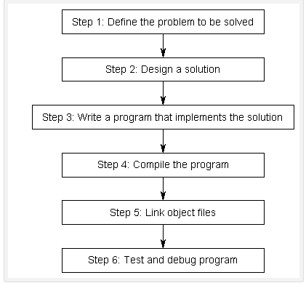
building a program

Slide 18
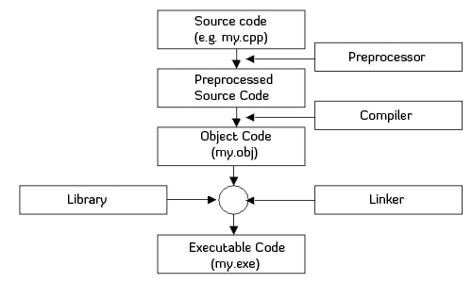
C++ toolchain
GoogleImages.com

Slide 19
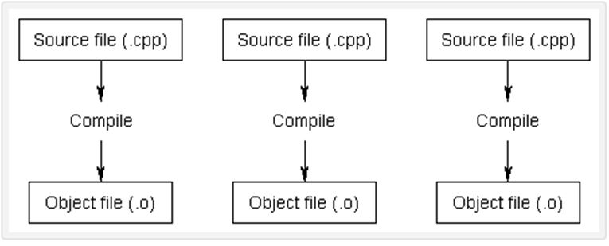
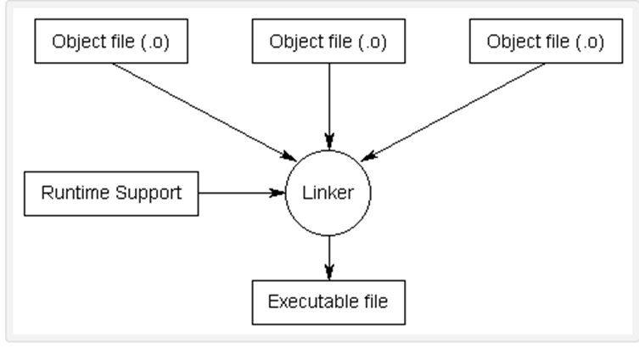
Compiler & Linker
Compiler converts source code
to machine language file(s) called
object file(s)
Next, Linker takes all complier
generated object files and creates
a single executable program that we
can run
Source: learncpp.com/cpp-tutorial

Slide 20
C++ Fundamental Data Types
C++ data types are similar to Java
The range of the numeric types such as int is heavily machine-dependent
In rare cases int could be 2-byte vs. the 4-byte in Java
Switch to long whenever the int range is not sufficient
Short and unsigned types can store numbers more efficiently; best to avoid these types at this stage
Java’s Boolean type is renamed as bool in C++
Notes:
Data types: char, int, float, double, long

Slide 21
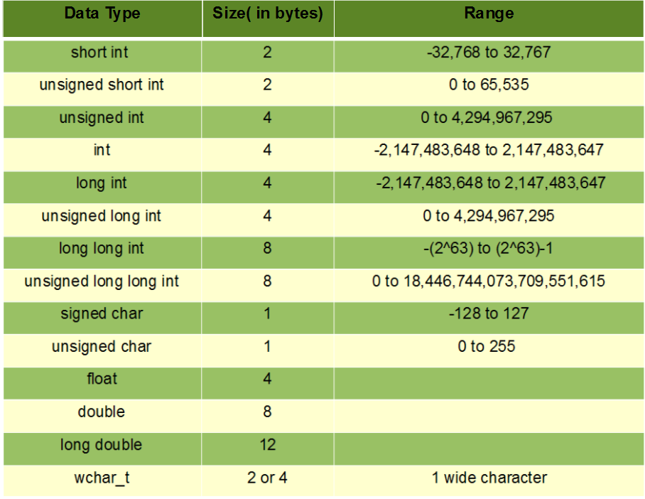
C++ Fundamental Data Types (cont.)

Slide 22
C++ string
The C++ string type is quite similar to the Java String type, but watch for following:
C++ strings store ASCII (American Standard Code for Information Interchange) characters, not Unicode characters (wait..)
C++ strings can be modified, whereas Java strings are immutable
The substring operation in C++ is called substr. The command s.substr(i, n) extracts a substring of length n starting at position i
C++ strings can be concatenated only with other strings, not with arbitrary objects
To compare strings, use the relational operators == != < <= > >=
More convenient than the use of equals() and compareTo() in Java
Comparison operators perform lexicographic comparison

Slide 23
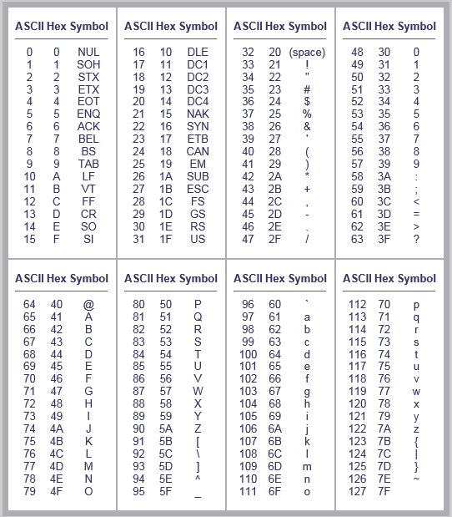
ASCII Codes Table
Notes:
American Standard Code for Information Interchange ( ASCII).

Slide 24
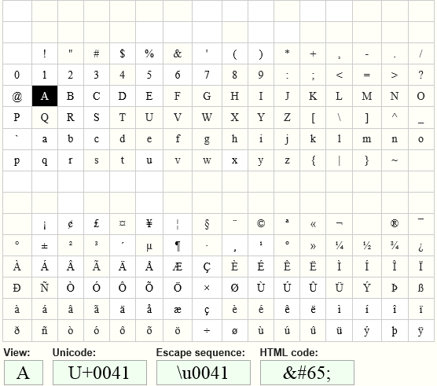
Unicode characters table

Slide 25
Variables & Constants
Unlike Java, C++ compiler does not check whether all local variables are initialized before they are read. If you forget to initialize the value of the variable, the value is then the random bit pattern that happened to be in the memory therefore a source of bugs

Slide 26
Error prone procedures
As in Java, data fields and static variables are allowed in classes
Global variables can be declared outside functions and classes and can be accessed from any function in a program That makes them difficult to manage; avoid global variables
Constants can be declared anywhere (in Java, they had to be static data of a class). C++ uses the const keyword instead of keyword final, in java
Example: const int DAYS_IN_WEEK = 7;

Slide 27
C++ file layout
In Java, we place our code in .java files
In C++, when one class depends on another class we need to let the compiler (pre-processor) know ahead of time using #include
This can present a problem if multiple classes depend on the same file, it might be included more than once
#pragma once (more later…)
Header guards (more later…)

Slide 28

Definition of classes
class Point
{
public:
Point();
Point(double xVal, double yVal);
void move(double dx, double dy);
double getX() const;
double getY() const;
private:
double x;
double y;
};
Point::Point() {x = 0; y = 0;}
void Point::move(double dx,
double dy)
{
x = x + dx;
y = y + dy;
}
double Point::getX() const
{
return x;
}
.h file
.cpp file

Slide 29
differences at a glance
In C++, there are public and private sections, started by the keywords public and private. In Java, each individual item is tagged with public or private
The class definition only contains the declarations of the methods. The actual implementations are listed separately
Accessor functions are tagged with the keyword const
There is a semicolon at the end of the class
The implementation of methods follows the class definition. Because the functions are defined outside the classes, each function name is prefixed by the class name
The :: operator ties in class and functions defined for that class

Slide 30
C++ Objects
C++ object variables hold values, not object references
new operator is never used when constructing objects in C++
Simply supply construction parameters after the variable name
Point point (1, 2); Construct point object
Point start; Construct point object with Point::Point(); -- in Java this creates an uninitialized reference
Point beginning = start; copies start into beginning; resulting in 2 independent objects
In Java, above command creates a second reference to the object, modifying the copy does not change the original

Slide 31
C++ functions
In Java, every function must be an instance method or a static function of a class
C++ supports that too, but it also permits functions that are not a part of any class, called global functions
Just like in Java, function arguments are passed by value
In Java, functions were able to modify objects
Since C++ object values are not references to actual objects, a function receives a copy of the actual argument and hence can never modify the original

Slide 32
C++ functions (cont.)
Therefore, C++ has two parameter passing mechanisms, call by value (as in Java) and call by reference
When a parameter is passed by reference, the function can modify the original. Call by reference is indicated by an & symbol behind the parameter type
void studentGrade (Student& sam, double grade)
{
. . .
}

Slide 33
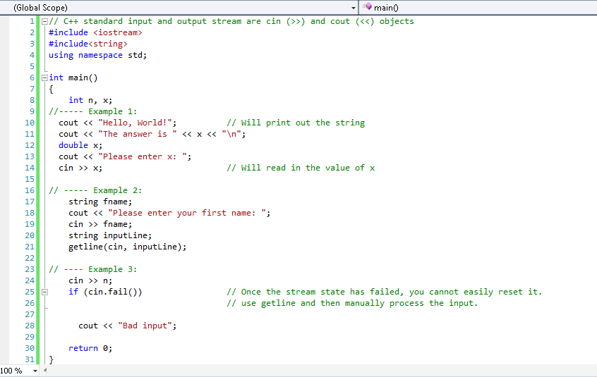
Simple Input & Output

Slide 34
Pre-processor
Before compiler goes to work, preprocessor processes your program
#include (pre-processor directive) statements will let preprocessor know that contents of other files are included
This format #include <fileName.h> tells the compiler to search a standard list of directories for the file you wish to include
This format #include “SomeClass.h” tells the compiler to search the current directory for the files in addition to the other directories

Slide 35
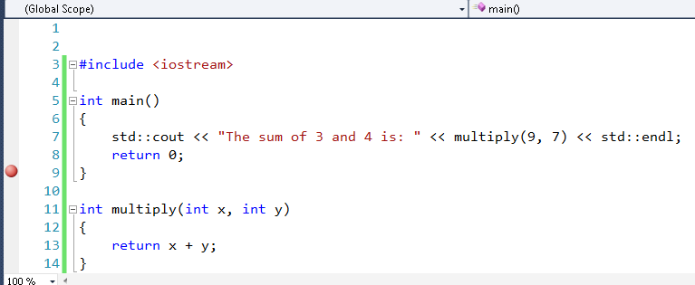

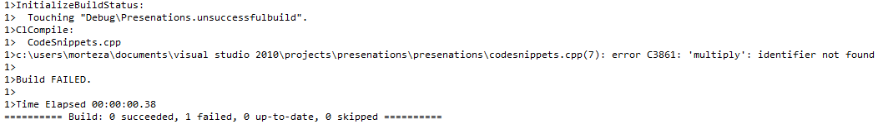
Function declarations order

Slide 36
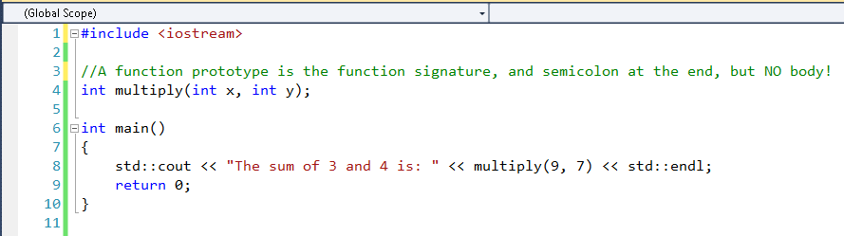
Forward declaration/ prototype
Now, complier is given prior notice about the existence of multiply() when main() calls it
Do you see an issue with declaring some functions before main() and some after main()?
Let’s say we’re writing a program that has two functions A and B. If function A calls
function B, and function B calls function A, then there’s no proper way to order the
functions. If you define A first, the compiler will complain it doesn’t know what B is.
If you define B first, the compiler will complain that it doesn’t know what A is.

Slide 37
What do prototypes do for you?
Prototypes ensure the following:
The compiler correctly handles the function return value
The compiler checks for correct number of arguments
The compiler checks correct use of data type as argument

Slide 38
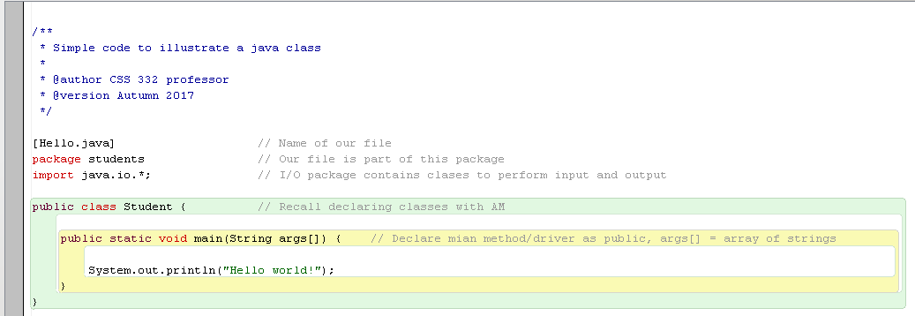
recall Java Program

Slide 39
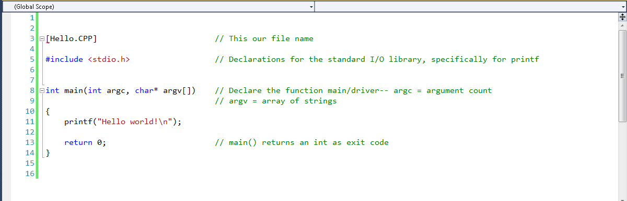
C++ Program
Functions don’t have to be methods of a class, such as printf and main -- Global
#include vs. import. Complier reads files containing class/function declarations
No package concept in C++ vs. Java package declarations
Main() function returns an integer, value of 0 = success; no such a thing in Java

Slide 40
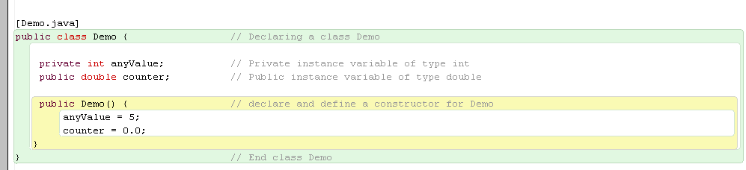
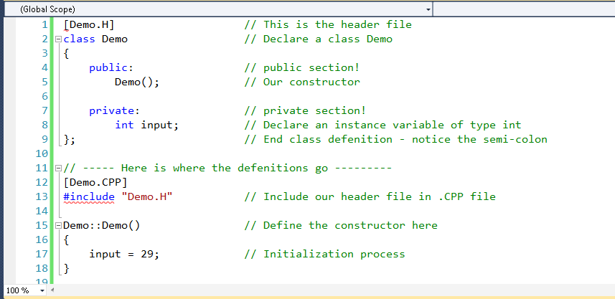
Java class vs. C++ class

Slide 41
program structure
A header file (.H)
Contains the class declarations for one or more classes
A program file (.CPP)
Contains function definitions, .CPP file includes the header file to know about the declarations
Advantages of separation of .h and .cpp files
Quickly check a header file for interfaces of a class, without need to see its implementation
It can speed up program compilation when the implementation of a class changes

Slide 42
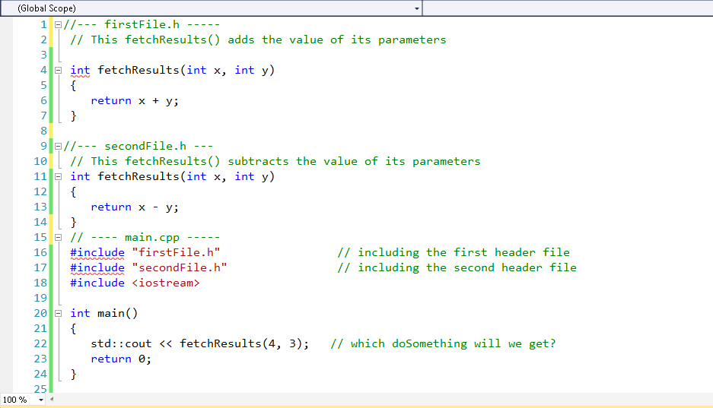
Dealing with naming collision

Slide 43
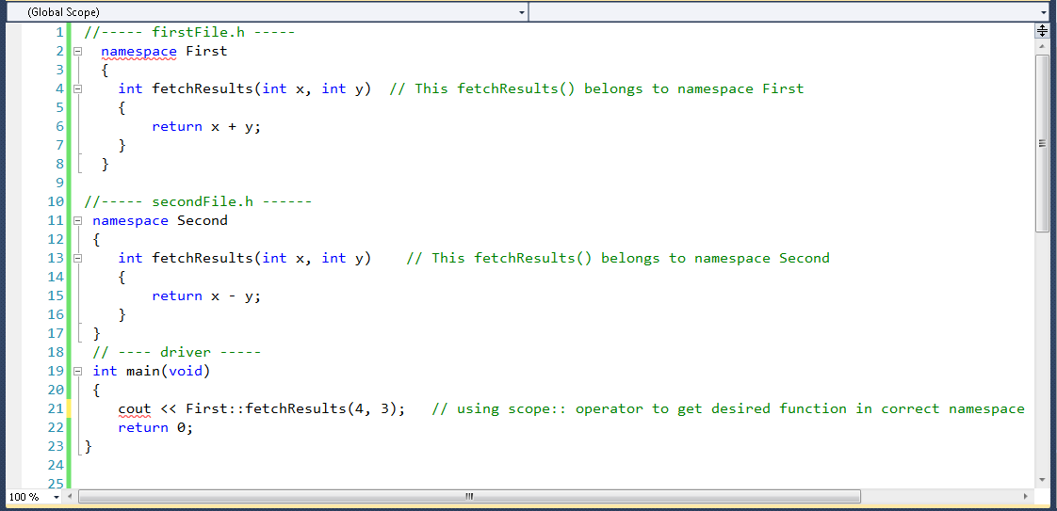
namespaces

Slide 44
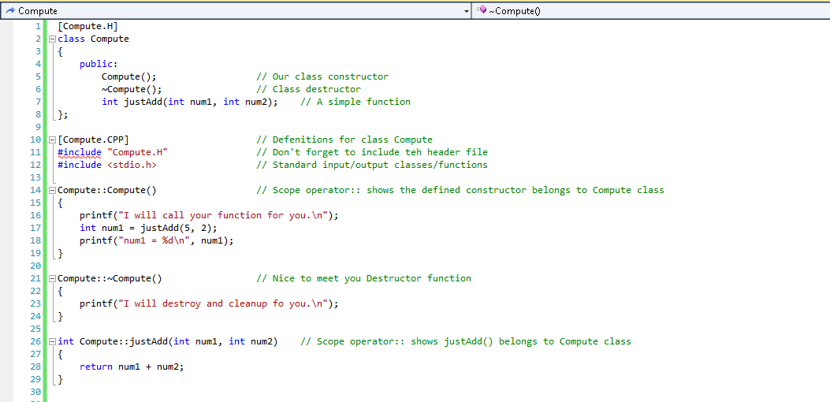
More sophisticated class

Slide 45
different kinds of variables in C++
Regular variables, commonly used; which hold values directly:
int x = 10;
Pointers, hold the address of another value (or null) and can be dereferenced to retrieve the value at the address they point to:
double* dPtr = new double(5.9);
References are the third basic type of variable that C++ supports.
A reference is a type of variable that acts as an alias to another object or value, declared using operator (&).

Slide 46
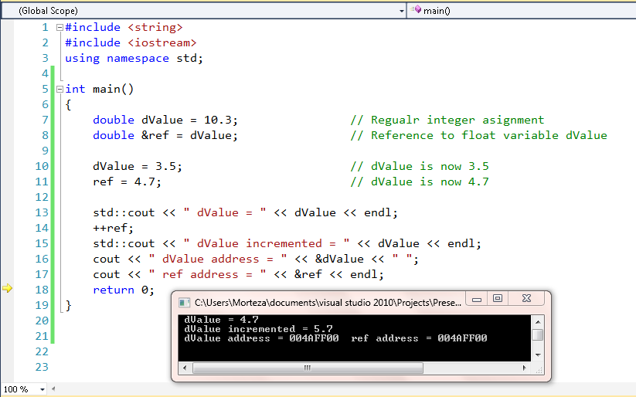
references (&) as alias
A reference acts as an alias to another object or value.
References generally act identically to the values they’re referencing

Slide 47
points about reference variables
References to non-const values
int value = 5; //simple integer
int &ref = value; //reference to variable value
References as aliases
cout << &value; //assume prints 0012DF9B
cout << &ref; //assume prints 0012DF9B
References must be initialized
int value = 5;
int &ref = value; //valid reference, initialized tovariable
int &invalidRef; //invalid, needs to reference something
References must be initialized.
No such thing as a null reference!

Slide 48
reference variables (cont.)
References can not be reassigned
int value1 = 9;
int value2 = 5;
int &ref = value1; //allowed, ref is now an alias for value1
ref = value2; //not allowed. Assigns value 5 to value1.
//does NOT change the reference! This //statement may not do what you might expect!
References as function parameters
void changeName(int &ref) { }

Slide 49

test your knowledge
Is this allowed?
const int y = 7;
int &ref2 = y;
No. you can’t initialize a non-const reference with a const object -- otherwise you’d be able to change the value of the const object through the reference, which would violate the const-ness of the object.

Slide 50
l-value r-value
C++ variables are a type of l-value & r-value
An l-value is a value that has a memory address
All variables are l-values since they have memory address
When making an assignment, the left hand side of the assignment operator must be an l-value/variable
A statement like 7 = 2; will cause a compile error, because 2 is not an l-value. The value of 7 has no memory, and thus nothing can be assigned to it. 7 means 7, and its value can not be reassigned
When an l-value has a value assigned to it, the current value at that memory address is overwritten

Slide 51

l-value R-value (cont.)
Consider the following case:
int x = 5;
x = x + 1;
Integer variable x is used in 2 different contexts:
As an l-value (variable with an address)
As an r-value
C++ processes x = x + 1 as x = 5 + 1;
Obviously, C++ will assign the value 6 back into variable x

Slide 52
l-value R-value (cont.)
The opposite of an l-value is r-value
An r-value refers to any value that can be assigned to an l-value.
Example: int x = 9; number 9 is an r-value
r-values are always evaluated to produce a single value
Examples of r-values are single numbers (such as 5, which evaluates to 5), variables (such as x, which evaluates to whatever value was last assigned to it)
Expressions such as 3 + x, which evaluates to the value of variable x plus 3 are also r-values since they evaluate to a single value
r-values have expression scope, values are destroyed at the end of expression in which they are created, e.g., std::cout << 2 + 3;

Slide 53
Handling end-of-file (eof) correctly
The eof() function -- infile.eof(), is a bool function which is true if the EOF character has been read, or false otherwise
Even though you read the last item in a file, the eof function may not be true yet
Often you have to read past the last item in the file to read the EOF character
Unix/Linux vs. Windows
Linux -- every line in a file has an End-Of-Line (EOL) character and the EOF character is after the last line. So unix/linux file's last line is stuff, EOL, EOF
Windows -- each line has an EOL characters except the last line whereas windows file's last line, if the cursor is on the line, is stuff, EOF

Slide 54

Test our Knowledge

